Slide 1

Weather Intelligence
Author: Jude Saad
Notes:
Preworks course home assignments

Slide 2
Table of Contents
Acknowledgments
About me
About my internship journey
About the app
How to use the app
Contact information

Slide 3
Acknowledgements
I want to express my deepest gratitude to Mr. Avishek for helping me build this project and to my parents for giving me this incredible opportunity. I am also thankful to Mr. Ken, my mentors, group members, friends, and the online resources that guided me through every step of this app development journey

Slide 4
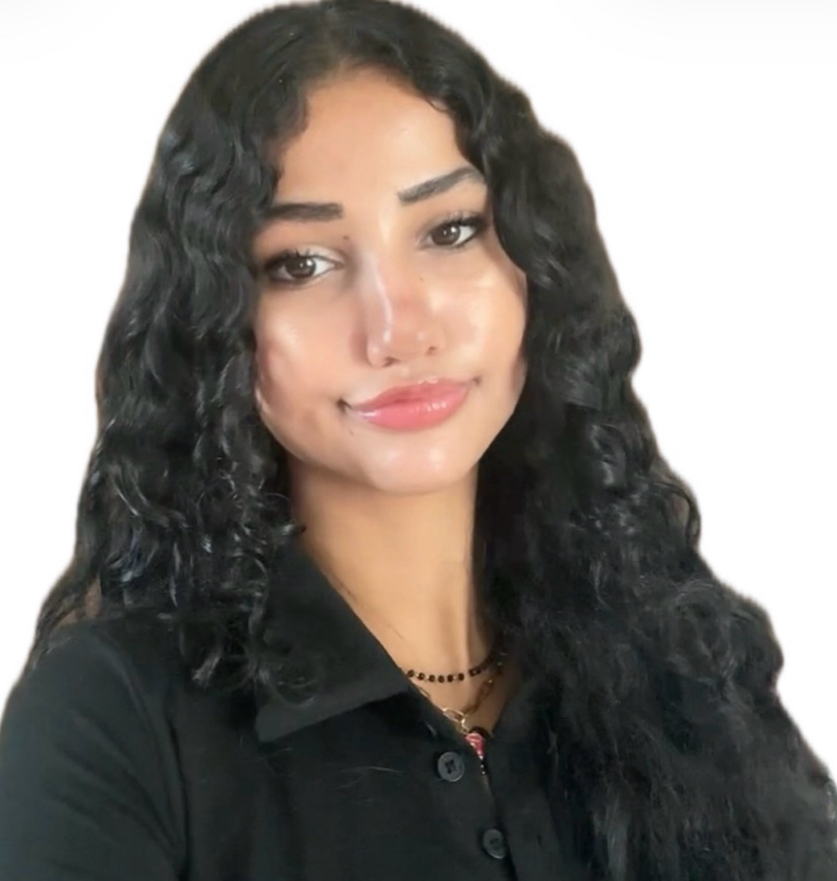
About Me..
L
I’m a 17-year-old student living in Dubai with a strong interest in Data Science and AI Engineering. I’m especially interested in how AI and data can be integrated into different industries to improve processes, solve real-world problems, and make work more efficient. I’m excited to continue developing my technical skills and explore how AI can create an impact across different fields.

Slide 5
About My Internship Journey with Clevered..
I had a great experience with Clevered, where I learned many new things and developed my skills in AI and data science. I also had the opportunity to apply what I learned by creating a meaningful and successful project.

Slide 6
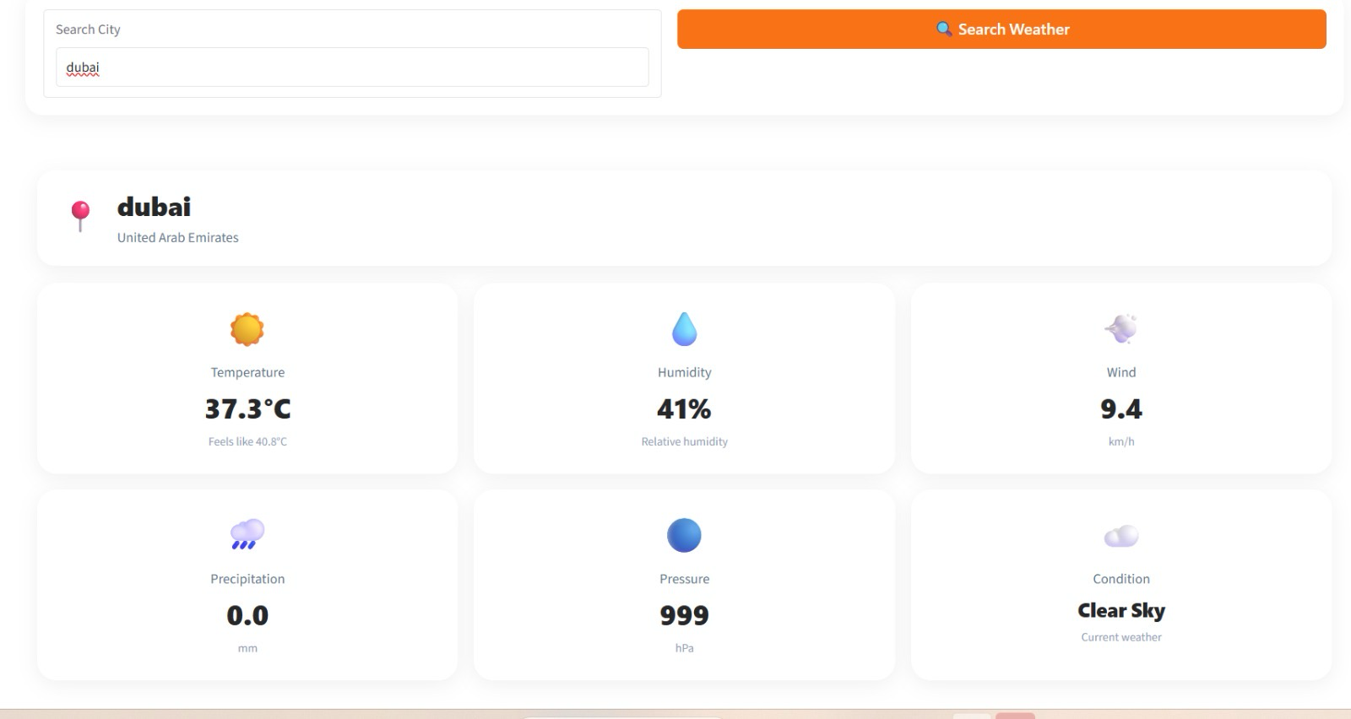
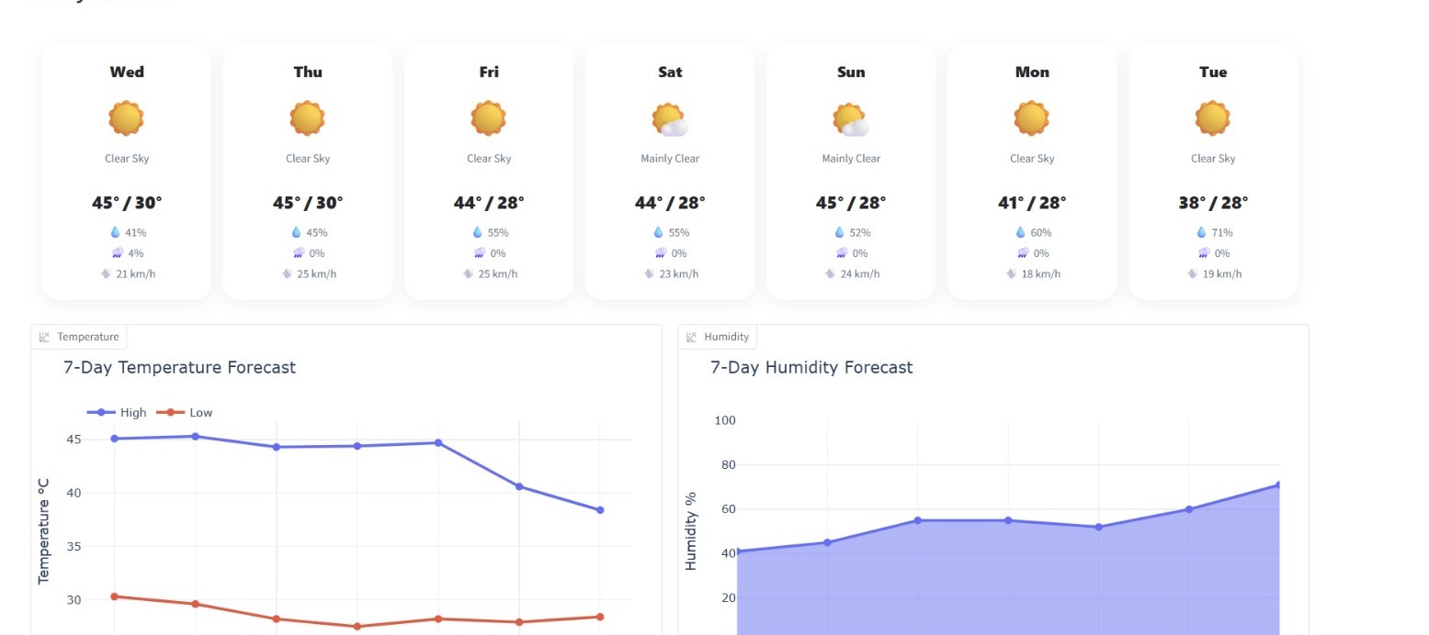
About App..
It’s a weather web app that lets you search for any city globally to check live conditions and weekly forecasts. It gives you a quick snapshot of key metrics like temperature, humidity, and wind speed, alongside interactive charts that make it easy to track weather trends over the week.

Slide 7
How do I use the App?

Slide 8
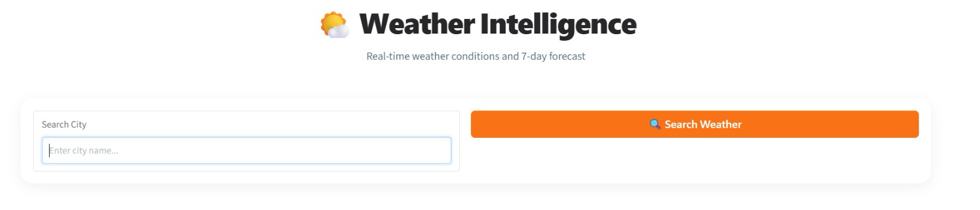
Option Name(This will be repeated for each option of the App)
Using the app is very simple since all you have to do is type in the city’s name which you’re interested in.

Slide 9
Contact Person
Gmail: judesaad670@gmail.com

Slide 10
Thank you!

